Slide 1
Web Programming
A brief introduction to HTML and CSS

Slide 2


1. Introduction
When we access to the Internet we use 2 different kind of computers
  Client
    Uses services and ask requests
  Server
    Offer services and give responses
Client
Request
Response
Server

Slide 3
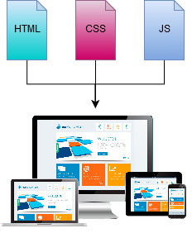
1. Introduction
A typical web page consist of:
  HTML file
    Web page structure and content
  CSS file
    Aesthetic aspects
  Javascript file
    Programming code

Slide 4
2. HTML
A HTML file contains:
  The logical structure of a web page
  Its content
    Headings
    Paragraphs
    Images
    Tables
HTML stands for Hyper Text Markup Language
The structure is described using tags
  <p>paragraph</p>
  <h1>Heading 1</h1>
  <h2>Heading 2</h2>
  <pre>Preformatted text</pre>
  And many more...

Slide 5
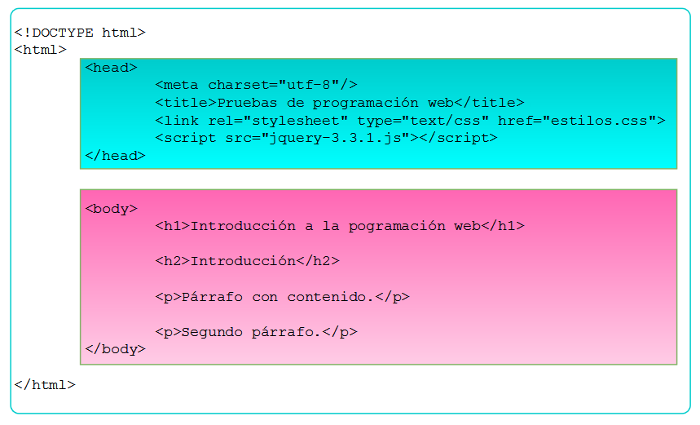
2.1 A HTML file structure
Head
  Technical information for the browser
Body
  Web content (text, images, buttons, tables...)

Slide 6
2.2. Our first HTML file
<!DOCTYPE html>
<html>
<head>
<meta charset="utf-8"/>
<title>Web programming</title>
</head>
<body>
<h1>My first web</h1>
<p>Hola caracola.</p>
<p>¡Mi primera web!</p>
</body>
</html>
Instructions:
  Copy the text and paste it on a text document file.
  Save it as index.html
  Open the document on a web browser
The browser will render the web page however he wants

Slide 7
3. CSS
CSS stands for Cascading Style Sheets
CSS describes how HTML elements are going to be displayed
The HTML limitation:
<h1>Hola</h1> is going to be rendered however the browser wants. We need a way to describe the visual appearance.
CSS rule example:
h1 {
  background-color: black;
  color: white;
  margin-left: 25 px;
}

Slide 8
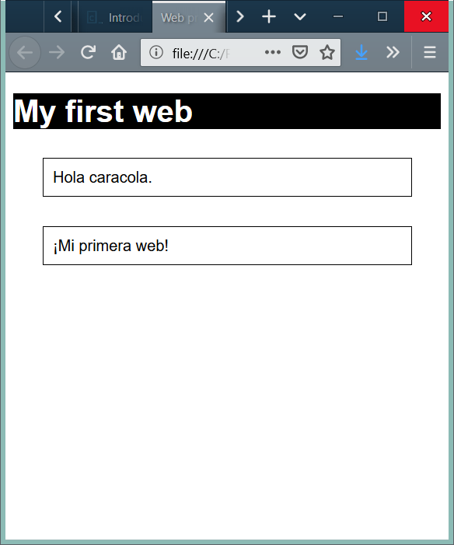
3.1 Linking the CSS to our first HTML file
Create a file called estilos.css in the same directory with this content:
h1 {
  background-color: black;
  color: white;
  margin: 25px;
  }
p{
  margin: 30px;
  border: 1px;
  border-style: solid;
  padding: 10px;
}
body {
  font-family: 'Arial', sans-serif;
}
Add this line in the head tag of the index HTML created before:
<link rel="stylesheet" type="text/css" href="estilos.css">

Slide 9

4. Javascript
JavaScript is used to program the behavior of web pages.
It can be used to perform actions when a button is clicked.
Javascript:
  ...is an imperative language
  …is an object-based scripting language
  ...is light weighted
  …is case-sensitive
  ...syntax is similar to c
  ...is not Java (they are not related by any means)
  ...is weakly typed (or dynamically typed)

Slide 10
4.1 Linking javascript to our first HTML file
<!DOCTYPE html>
<html>
<head>
  <meta charset="utf-8"/>
  <title>Web programming</title>
  <link rel="stylesheet" type="text/css" href="estilos.css">
</head>
<body>
  <h1>My first web</h1>
  <p>Hola caracola.</p>
  <p>¡Mi primera web!</p>
  <script src="code.js"></script>
</body>
</html>
Create a file called code.js in the same directory with this content:
alert("¡Hola caracola!");
Add this line at he end of the body tag of the index HTML created before:
<script src="code.js"></script>
We will always include Javascript using that method in our HTML files.

